Slide 1
Hotel Aggregator
Data Visualization By Power Bi

Slide 2
Overview
Abstract
Dataset
Import Data
Dashboard
Insights

Slide 3
Abstract
This internship project aims to analyze a dataset of hotel aggregator listings using Power BI. The dataset comprises various attributes related to listings, hosts, reviews, and availability. The objective is to create comprehensive visualizations and insights that shed light on trends, patterns, and factors influencing the performance of listings.

Slide 4

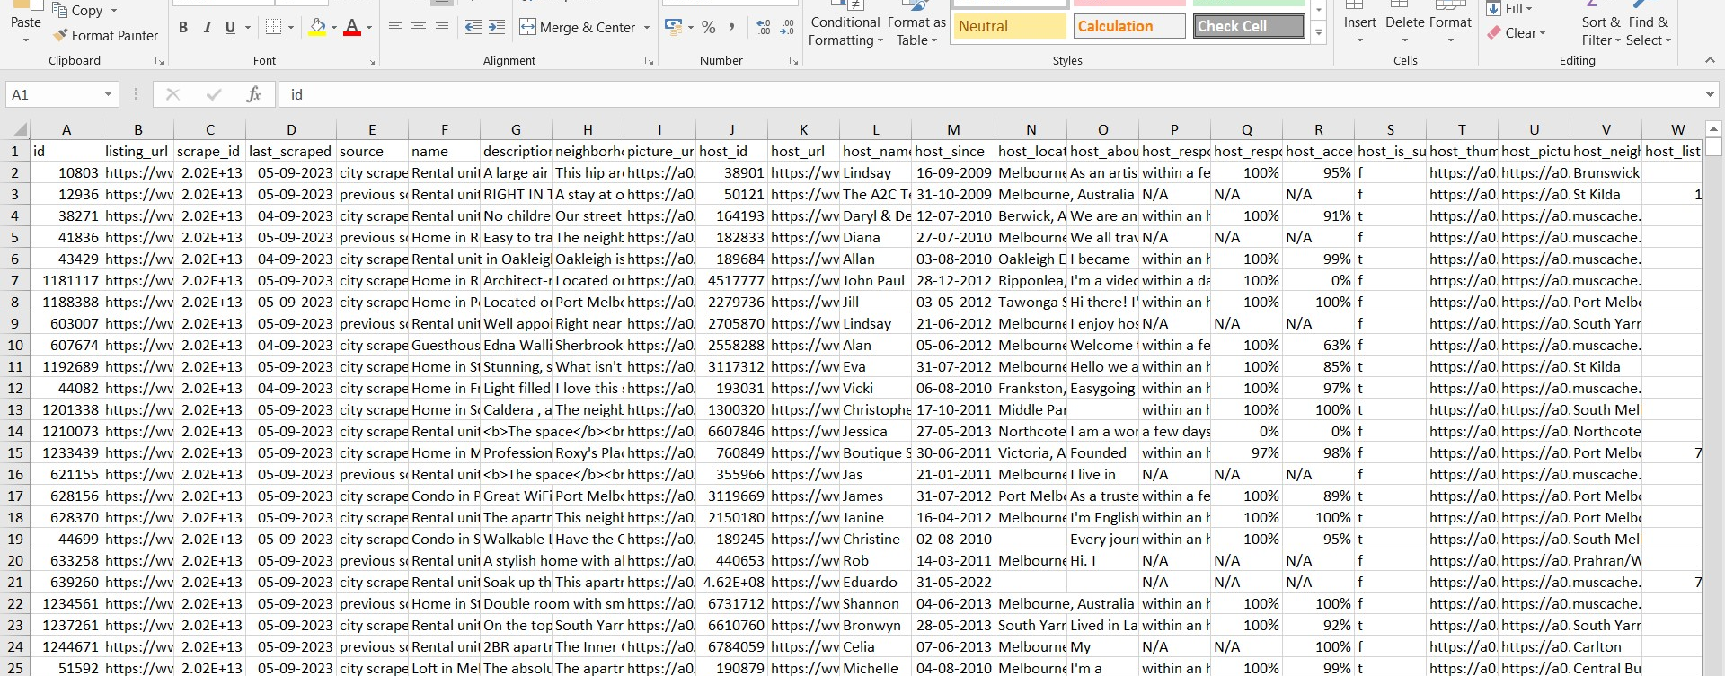



Dataset

Slide 5
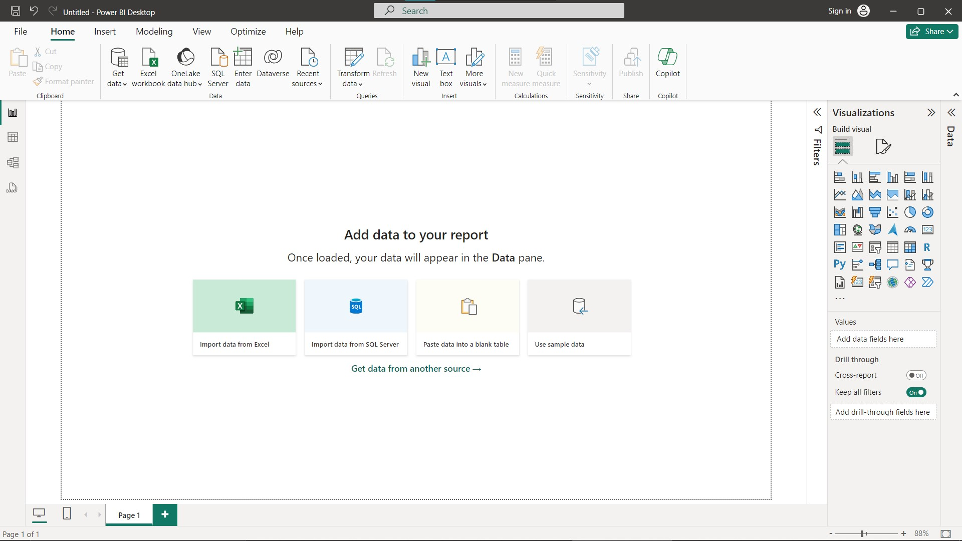
Import Data

Slide 6
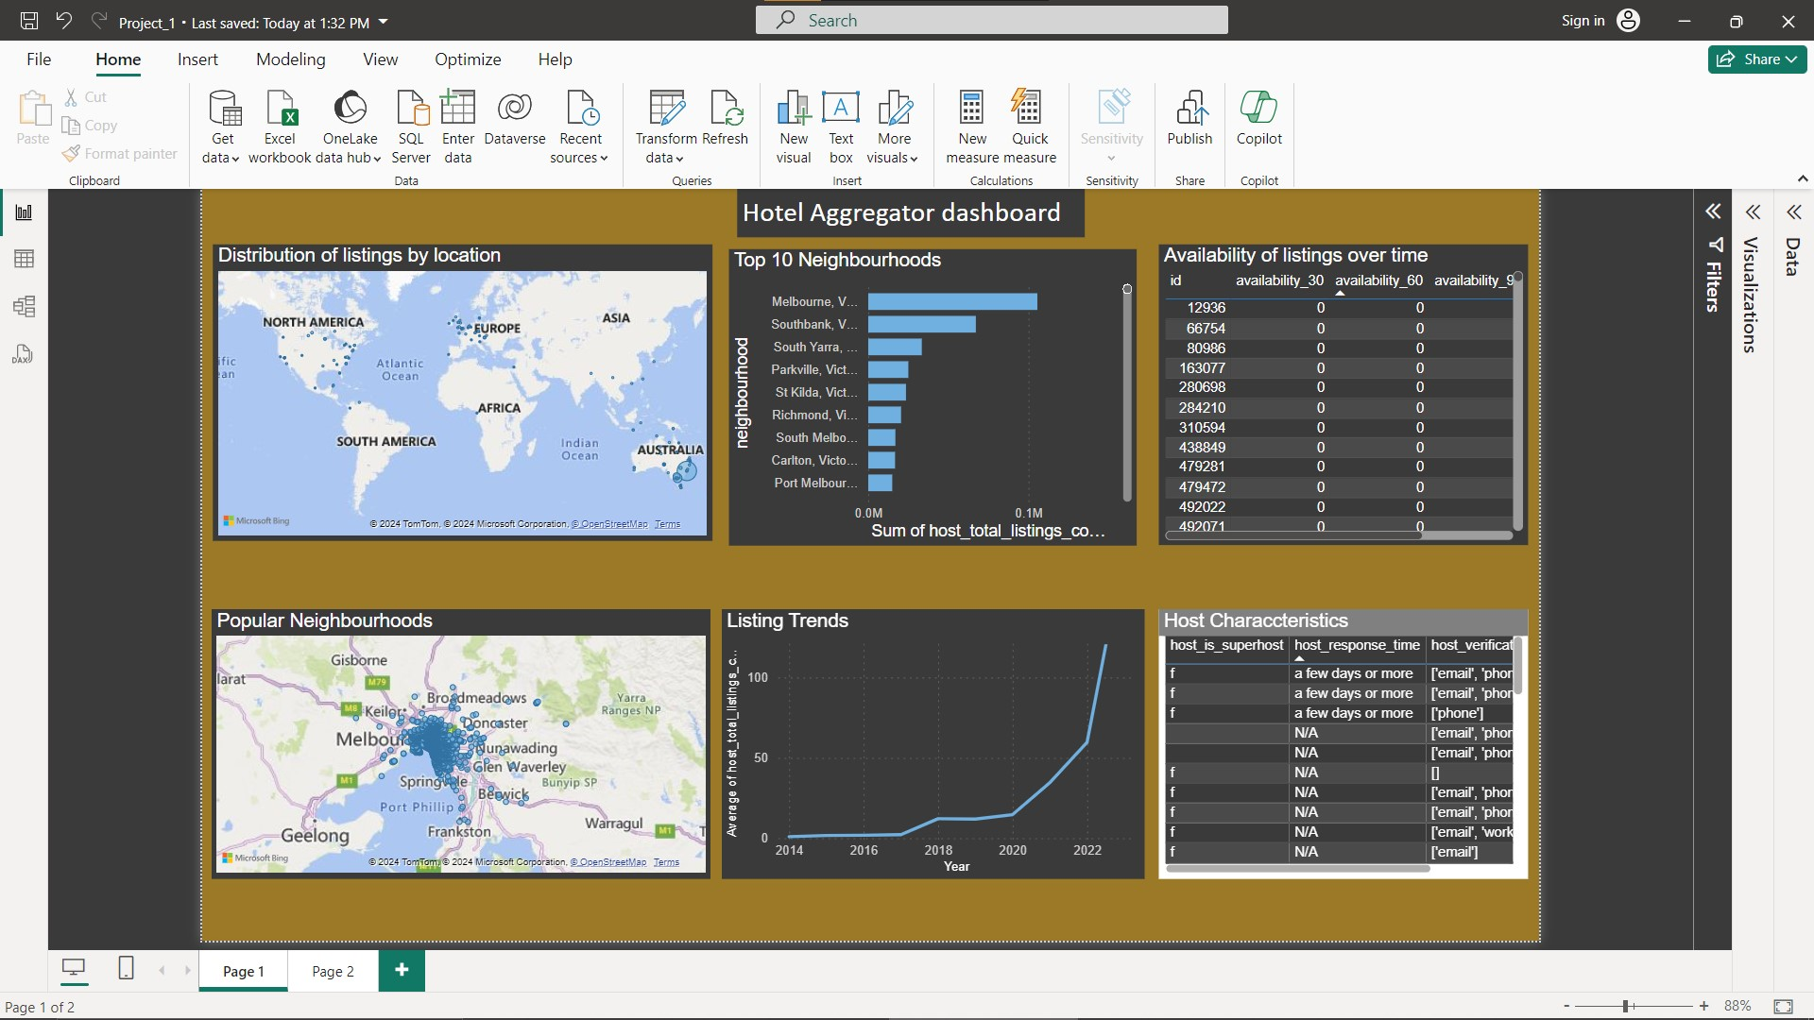
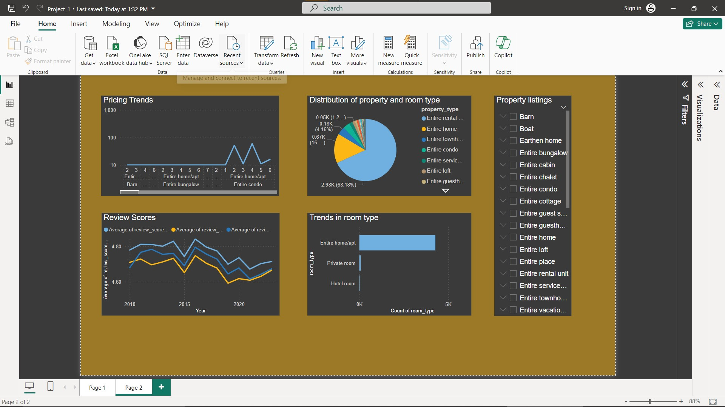
Dashboard

Slide 7


Insights
Listings had spread across the world over many countries but most of the neighborhoods are spotted at Melbourne, Australia.
Majority of the listings are entire rental units, indicating a strong demand for a whole property.
Property types such as Barns, Boats and Buses have low presence in the listings, suggesting an opportunity to diversify and offerings.
When we look deeper into listing trends over year, 2022 took a top spot by indicating a growing demand for short-term rentals.

Slide 8

Thank you

